Slide 1
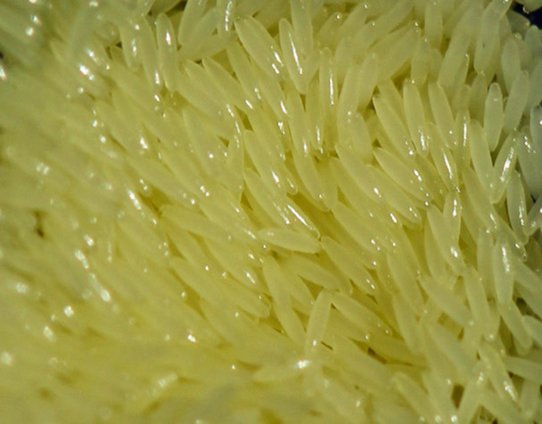
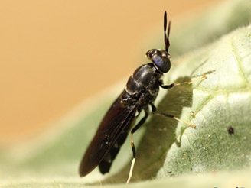
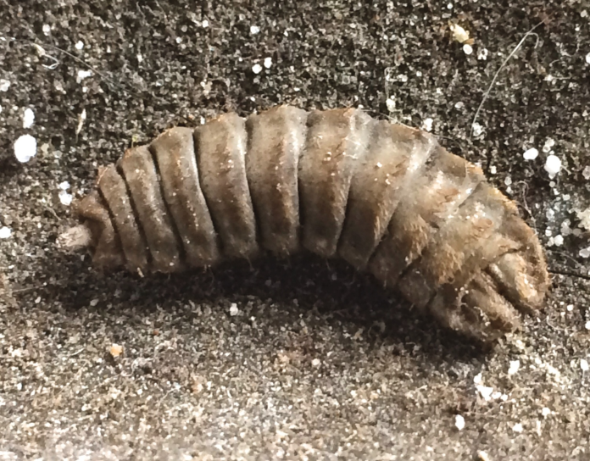
The Black Soldier Fly, Hermetia illucens
(Diptera: Stratiomyidae)
Brydie Piaf
Christy Harrington

Slide 2
The world’s biggest fly-farmer and first commercial-scale insect meal producer, AgriProtein is building a global network of insect protein factories mass-producing sustainable animal feeds to replace fishmeal used in aquaculture, agriculture and pet food.
AgriProtein has developed a standard 250 ton per day plant with the capacity to build up to 25 of these factories per year, two factories a month.
AgriProtein aims to build 20 black soldier fly farms in the U.S. and Canada in pursuit of its global targets of 100 fly farms by 2024 and 200 by 2027.

Slide 3
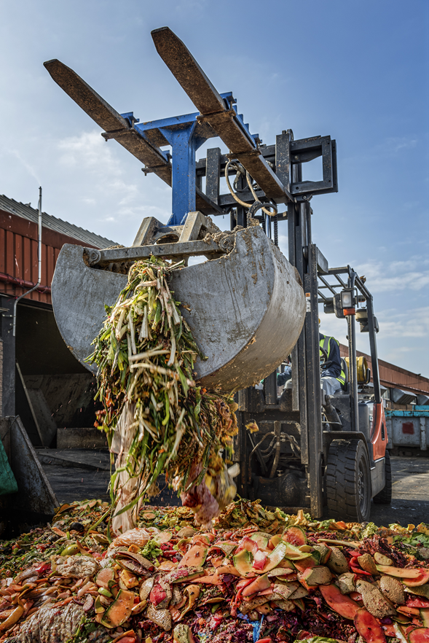
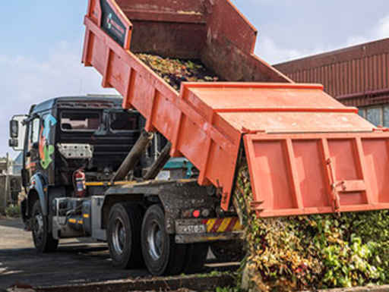
Production: 110 tons of organic waste converted into 22 tons of BSF larvae

Slide 4
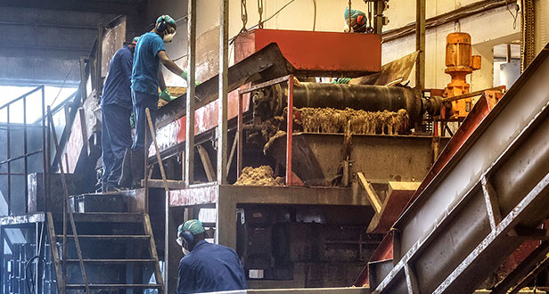
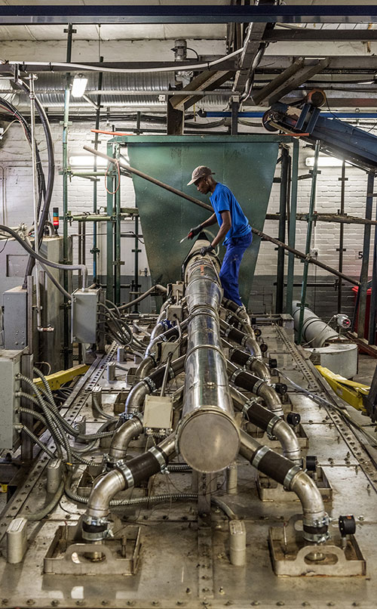
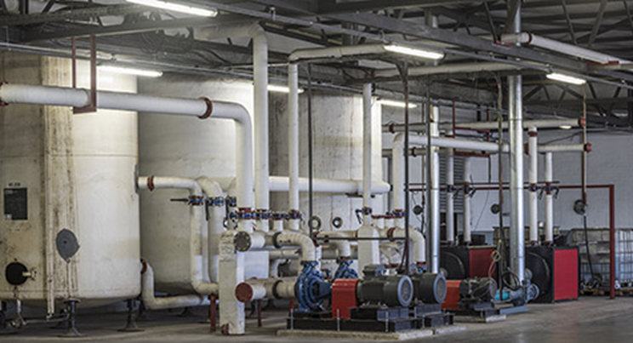

Slide 5
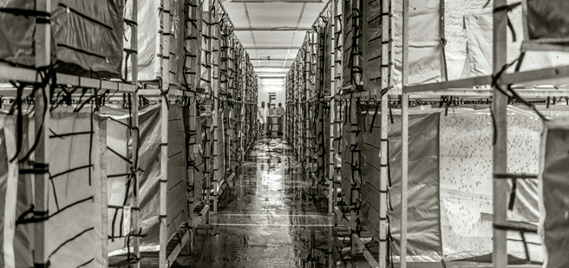
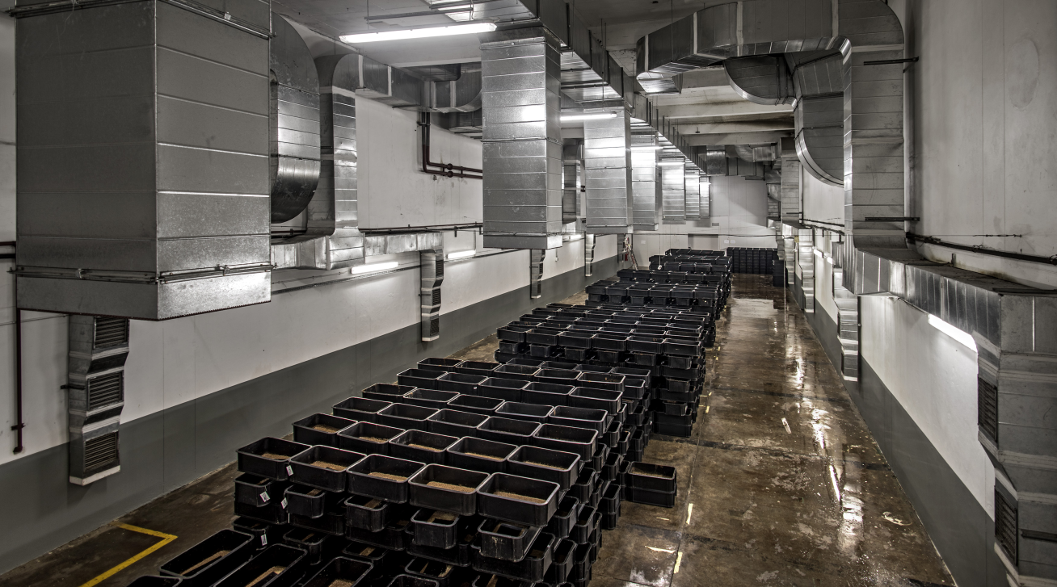

Slide 6
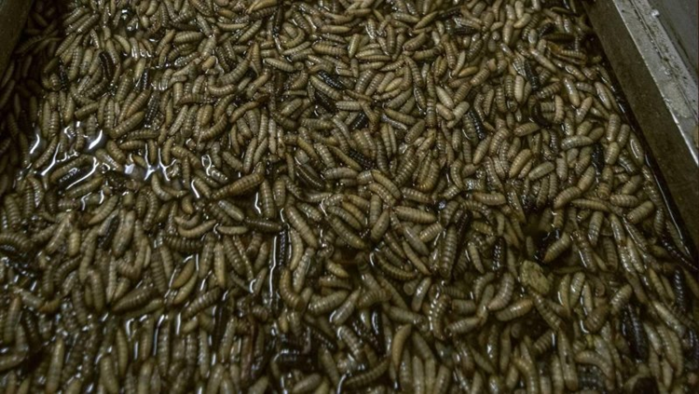
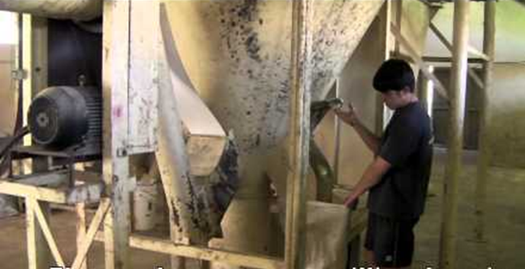
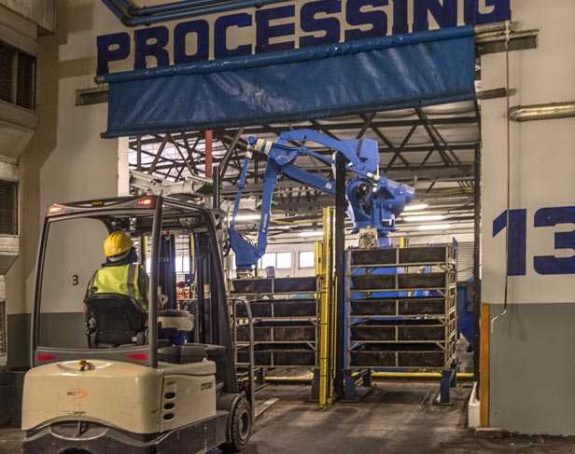
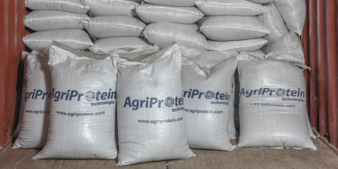

Slide 7
